Slide 1

Derivative Implicit Differentiation
RCET 0264 Introductory Calculus
Tim Leishman

Slide 2
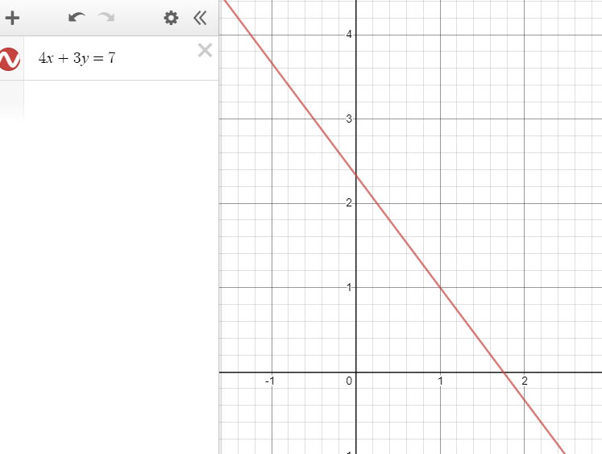

Implicit Differentiation
Example 1:
$$4x+3y=7$$
$4x+3y=7$
$\left(4\right)\left(1\right)\left(x^{1−1}\right)+\left(3\right)\left(1\right)\left(y^{1−1}\right)\left(y^{′}\right)=\left(7\right)\left(0\right)\left(NA\right)$
$\left(4\right)\left(1\right)\left(1\right)+\left(3\right)\left(1\right)\left(1\right)\left(y^{′}\right)=0$
$4+3\left(y^{′}\right)=0$
Solve for $y^{′}$ $\left(y^{′}=\frac{dy}{dx}\right)$:
$3\left(y^{′}\right)=−4$
$y^{′}=\frac{−4}{3}$

Slide 3
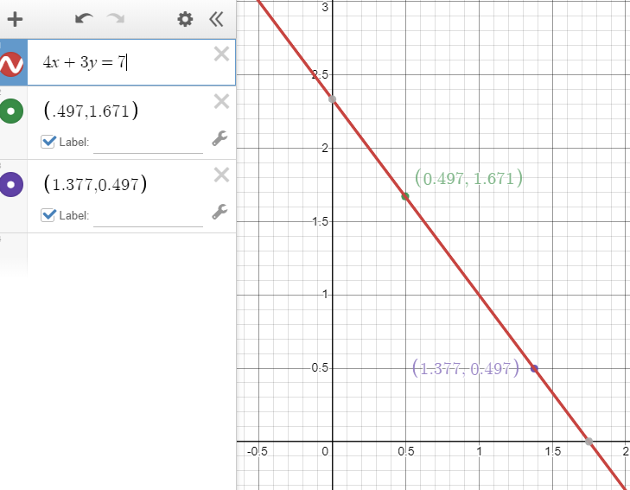

Implicit Differentiation
Example 1:
$$4x+3y=7$$
$$y^{′}=\frac{−4}{3}$$
Verify $y^{′}=\frac{dy}{dx}$
$\frac{∆y}{∆x}=\frac{1.671−0.497}{.497−1.377}$
$\frac{∆y}{∆x}=$-1.334
$y^{′}=\frac{−4}{3}=−1.333$
☑

Slide 4

Implicit Differentiation
Example 2:
$$x^{2}+y^{2}+4y=0$$
$\left(2\right)\left(x\right)+\left(2\right)\left(y\right)\left(y^{′}\right)+\left(4\right)\left(1\right)\left(y^{′}\right)=0$
$2x+2yy^{′}+4y^{′}=0$
$2yy^{′}+4y^{′}=−2x$
$y^{′}\left(2y+4\right)=−2x$
$y^{′}=\frac{−2x}{2y+4}$
$y^{′}=\frac{2(−x)}{2(y+2)}$
$y^{′}=\frac{−x}{y+2}$

Slide 5

Implicit Differentiation
Example 3:
$$y^{4}−2y^{2}x^{2}+{3x}^{2}=0$$
$4y^{3}y^{′}−\left[4yy^{′}x^{2}+2x2y^{2}\right]+6x=0$
$4y^{3}y^{′}−4yy^{′}x^{2}−4xy^{2}+6x=0$
$4y^{3}y^{′}−4yy^{′}x^{2}=4xy^{2}−6x$
$y^{′}(4y^{3}−4yx^{2})=4xy^{2}−6x$
$y^{′}=\frac{4xy^{2}−6x }{4y^{3}−4yx^{2}}$
$y^{′}=\frac{2(2xy^{2}−3x) }{2(2y^{3}−2yx^{2})}$
$y^{′}=\frac{2xy^{2}−3x }{2y^{3}−2x^{2}y}$

Slide 6
References:
Ewen, D., Gary, J. S., & Trefzger, J. E. (2005). Technical calculus. Upper Saddle River, NJ: Pearson/Prentice Hall.
Richmond, A. E., & Hecht, G. W. (1995). Calculus for electronics. New York: Glence.
https://www.desmos.com

